Slide 1
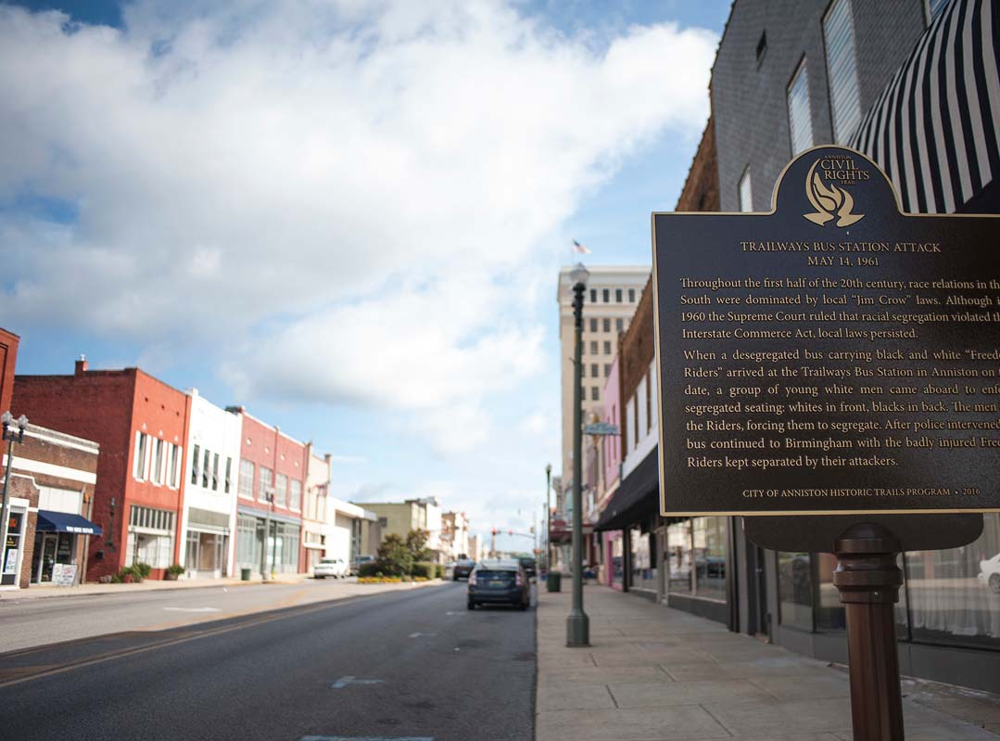
City of Anniston, AL
FY 2024 Audit Results

Slide 2
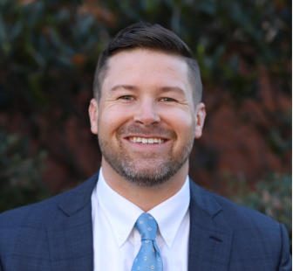
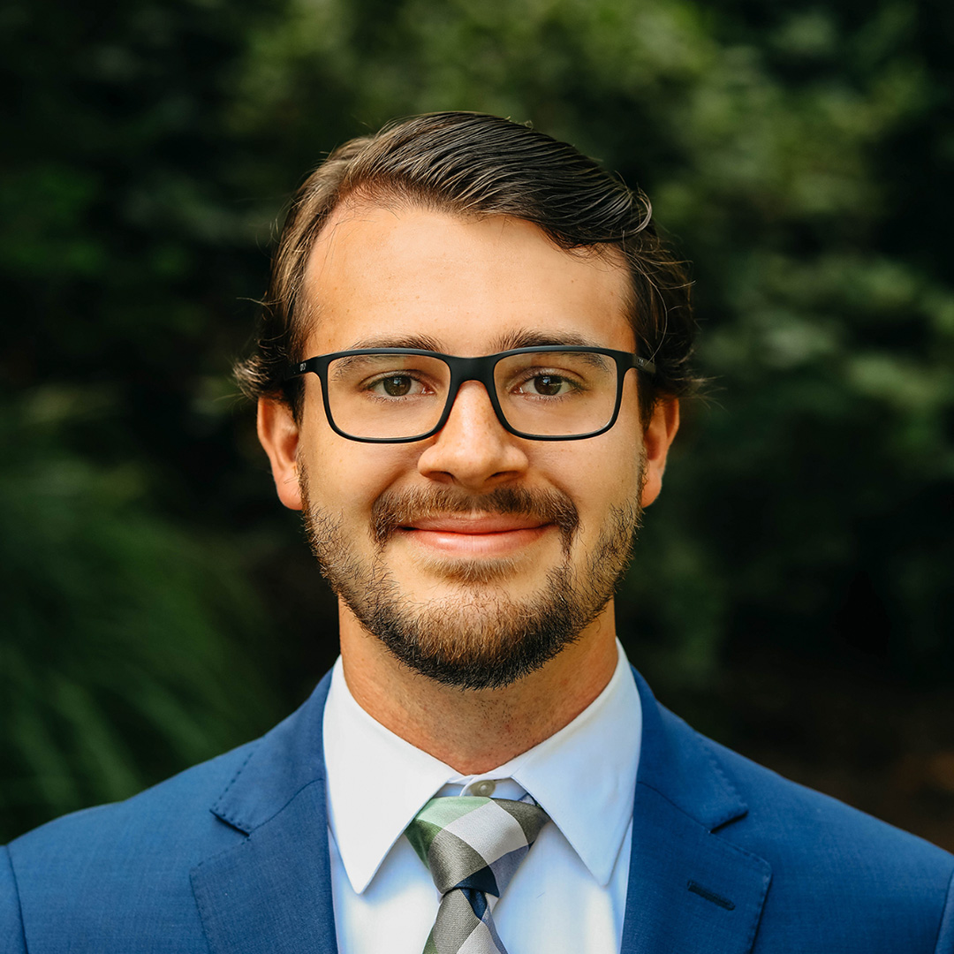
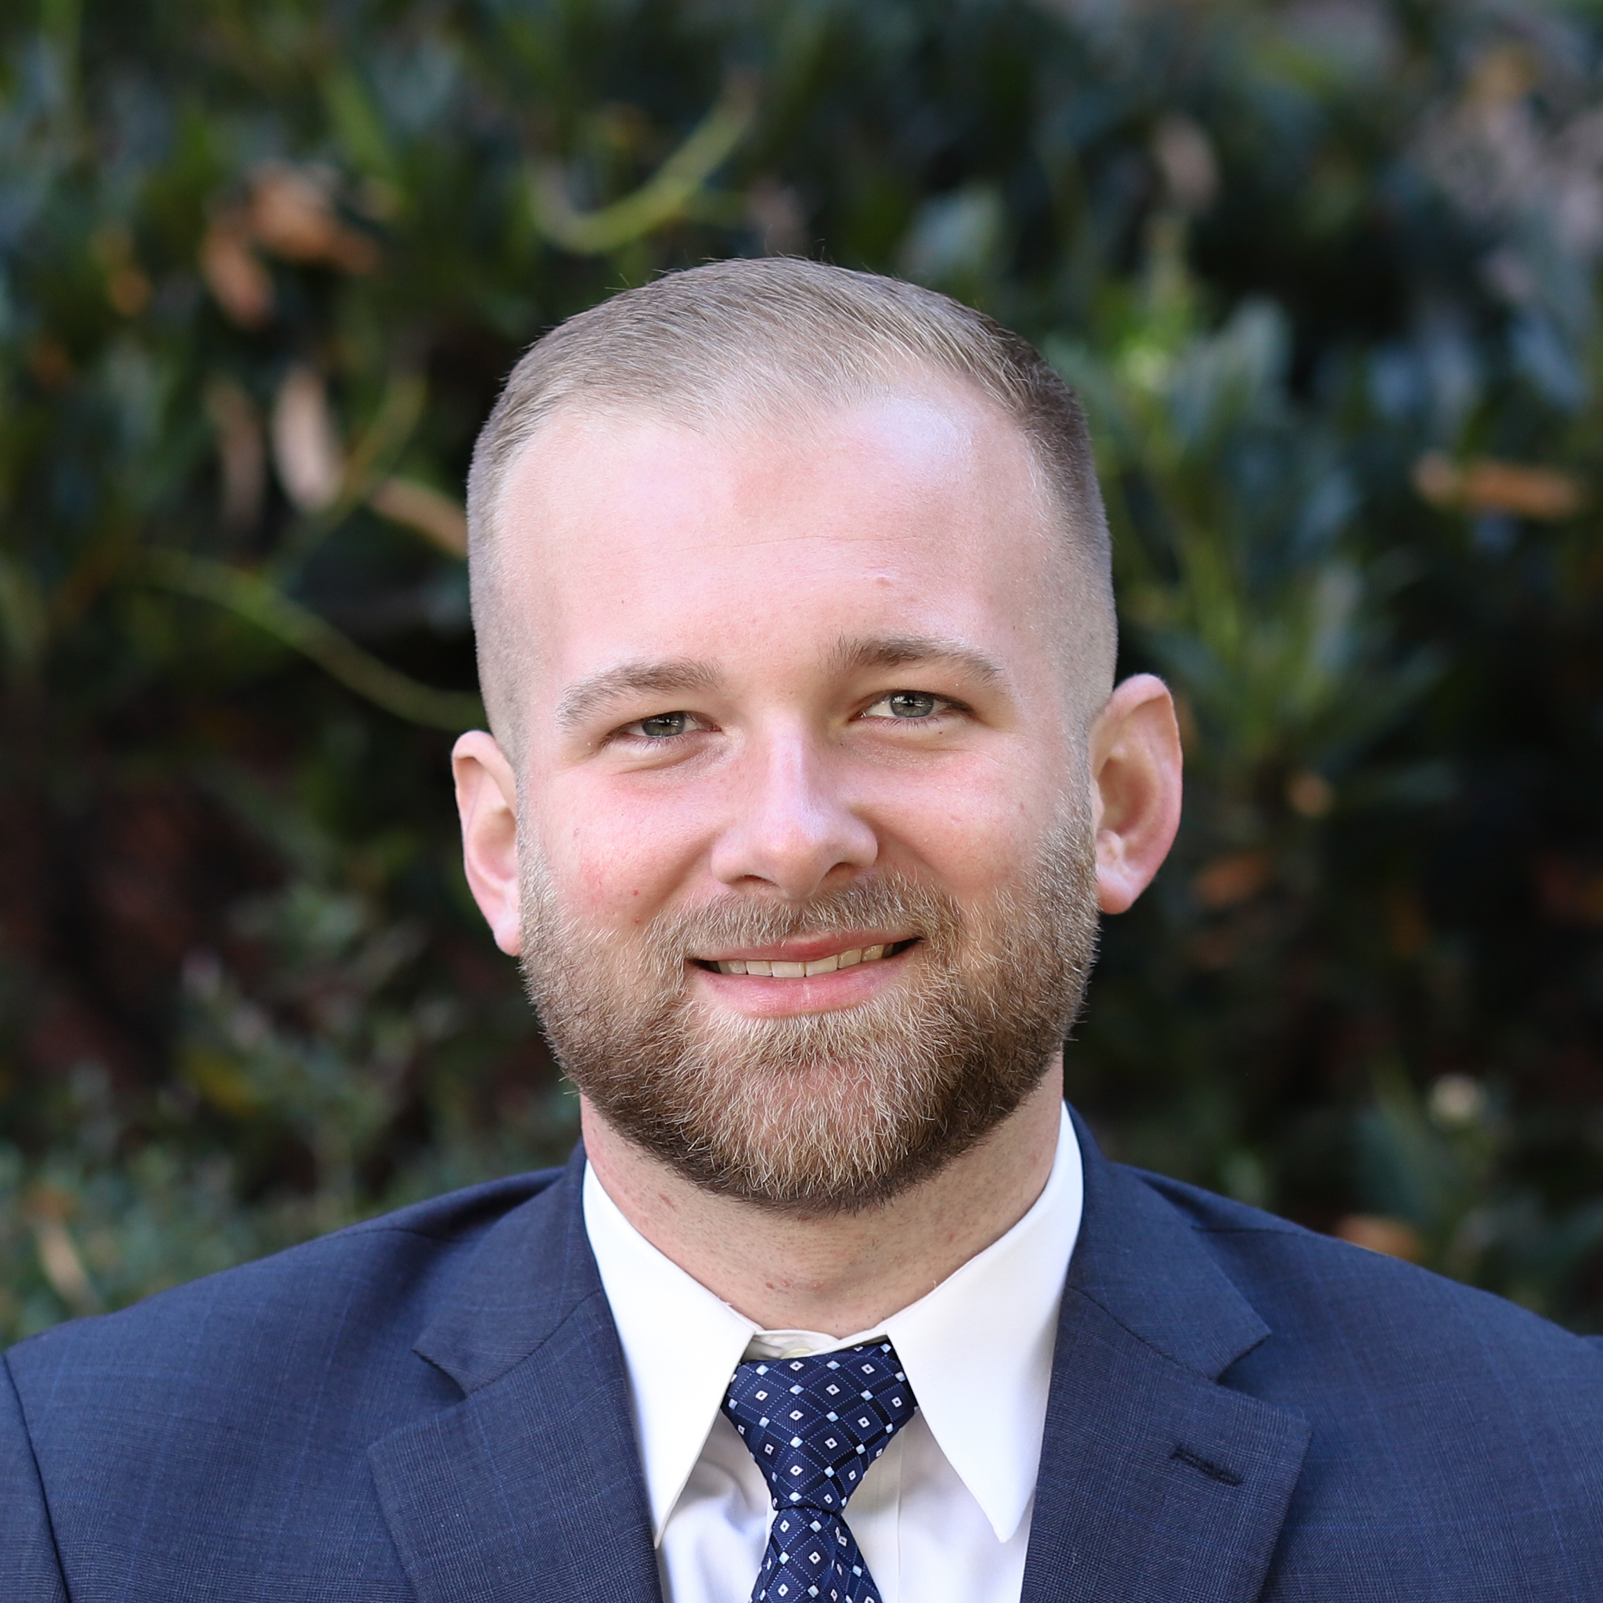

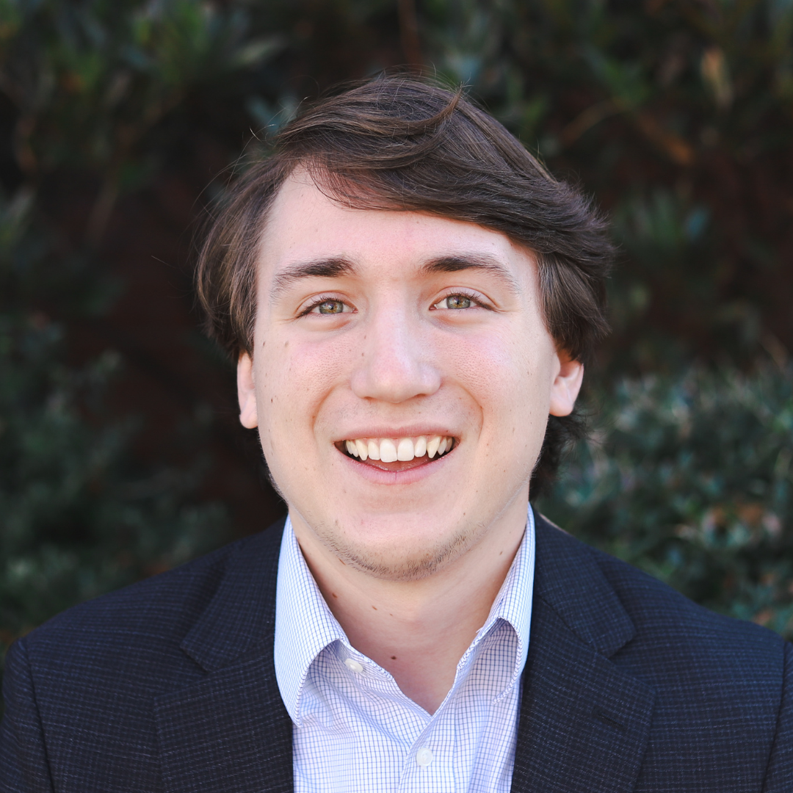
HHM Engagement Team
Brock Oliver, CPA
Garrett Williams, CPA
Josh Shoemaker, CPA
Griffin Tucker
Joel Sauve
Partner
Audit Manager
Audit Supervisor
Audit Senior
Audit Staff

Slide 3

Agenda
Scope of Services
Audit Results
Required Communications
Financial Highlights

Slide 4


Scope of Services
Financial Statement Audit
Single Audit (Federal Funds)

Slide 5

What is an audit?
A financial statement audit is an independent examination of an entity's financial statements to ensure they are accurate, complete, and comply with applicable accounting standards (e.g., GAAP).
Provide reasonable assurance that the financial statements are free from material misstatements, whether due to fraud or error.
Testing Financial Records: Review of transactions, balances, and disclosures based on risk factors.
An Independent Auditor’s Report, which includes an opinion on whether the financial statements are free from material error

Slide 6


Identified Risks
Where Do We Spend Our Time?
Internal Controls
Capital Assets
Revenue Recognition
Grant Compliance

Slide 7



Financial Statement Audit Results
Audit Opinion is Unmodified
Report on Internal Controls
Highest Level of Assurance
No material weaknesses or significant deficiencies in the CY or PY

Slide 8
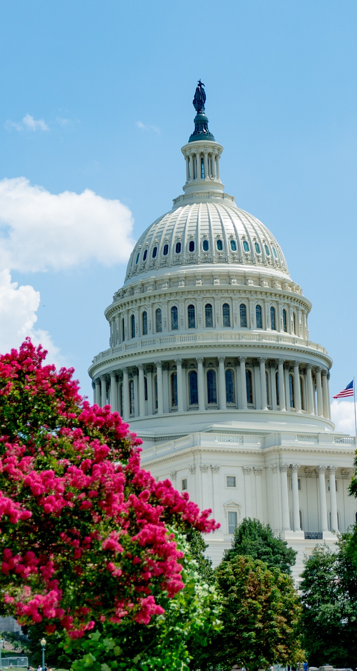

Single Audit Results
Major Program Tested
Audit Opinion is Unmodified
Report on Internal Controls
ALN 21.027
Covid Monies (ARPA)
Highest Level of Assurance
No material weaknesses or significant deficiencies in the CY or PY

Slide 9
Required Communications
SAS-114 Communication with Governance
Overall
Difficulties
No changes in accounting policies
No consultations with other accountants
No fraud or significant matters discussed with management.
No disagreements or difficulties with management. There are no other findings to report.
Estimates
Other
Accounting estimates are reasonable.
The uncorrected misstatements proposed are deemed immaterial to the financial statements as a whole.

Slide 10
General Fund Budgetary Highlights
 | Original Budget | Final Budget | Actual | Variance
Total Revenues | $ 45,419,775 | $ 46,865,624 | $ 49,980,054 | $ 3,114,430
Expenditures
General Government | $ 13,331,350 | $ 13,284,182 | $ 12,780,035 | $ 504,147
Judicial | $ 474,725 | $ 475,225 | $ 449,407 | $ 25,818
Public Safety | $ 15,819,150 | $ 16,084,632 | $ 15,796,751 | $ 287,881
Public Works | $ 7,200,375 | $ 7,251,748 | $ 6,898,851 | $ 352,897
Economic Development | $ 702,475 | $ 746,675 | $ 729,688 | $ 16,987
Culture and Recreation | $ 4,385,323 | $ 4,538,844 | $ 4,353,938 | $ 184,906
Total Expenditures | $ 41,913,398 | $ 42,381,306 | $ 41,008,670 | $ 1,372,636
Excess Revenues over Expenditures | $ 3,506,377 | $ 4,484,318 | $ 8,971,384 | $ 4,487,066
Other Financing Sources (Uses) | $ (3,736,353) | $ (5,554,930) | $ (7,898,070) | $ (2,343,140)
Net Change in Fund Balance | $ (229,976) | $ (1,070,612) | $ 1,073,314 | $ 2,143,926

Slide 11
General Fund Analysis
Fund Balance as Compared to Total Expenditures
General Fund Balance at September 30, 2024 = $21,286,510
Unassigned Fund Balance at September 30, 2024 = $20,936,468
Total Expenditures (inc. transfers) = $50,886,618
Ratio of Unassigned Fund Balance to CY Expenditures = 41% or 5 months
Recommended Range = 16% - 33% or 2 – 4 months

Slide 12

Q&A

Slide 13
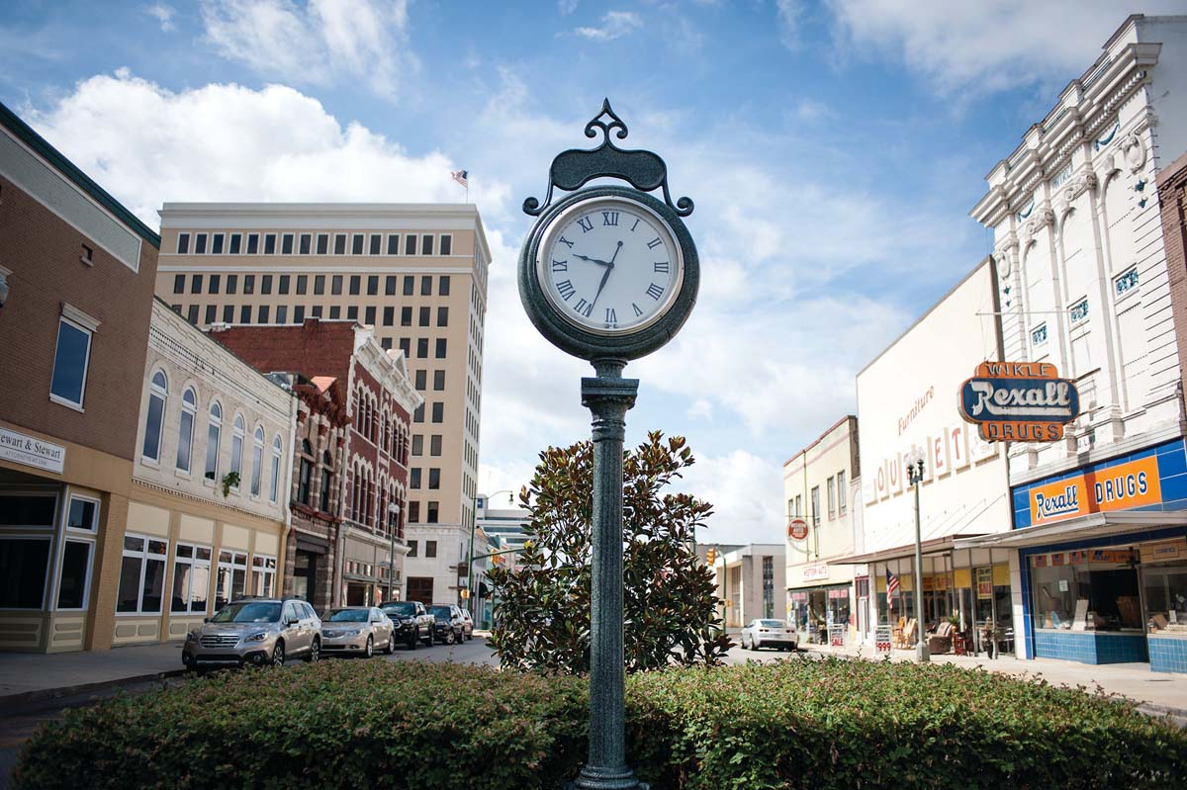

HHM CPAs
266 Inman Street E
Cleveland, TN
423-813-9863
gwilliams@hhmcpas.com
Garrett Williams, CPA

